Slide 1
Wireless Sensor Networks
Applications

Slide 2
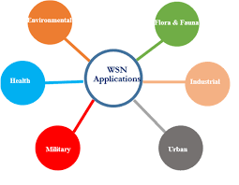
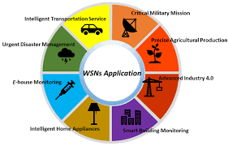

Slide 3
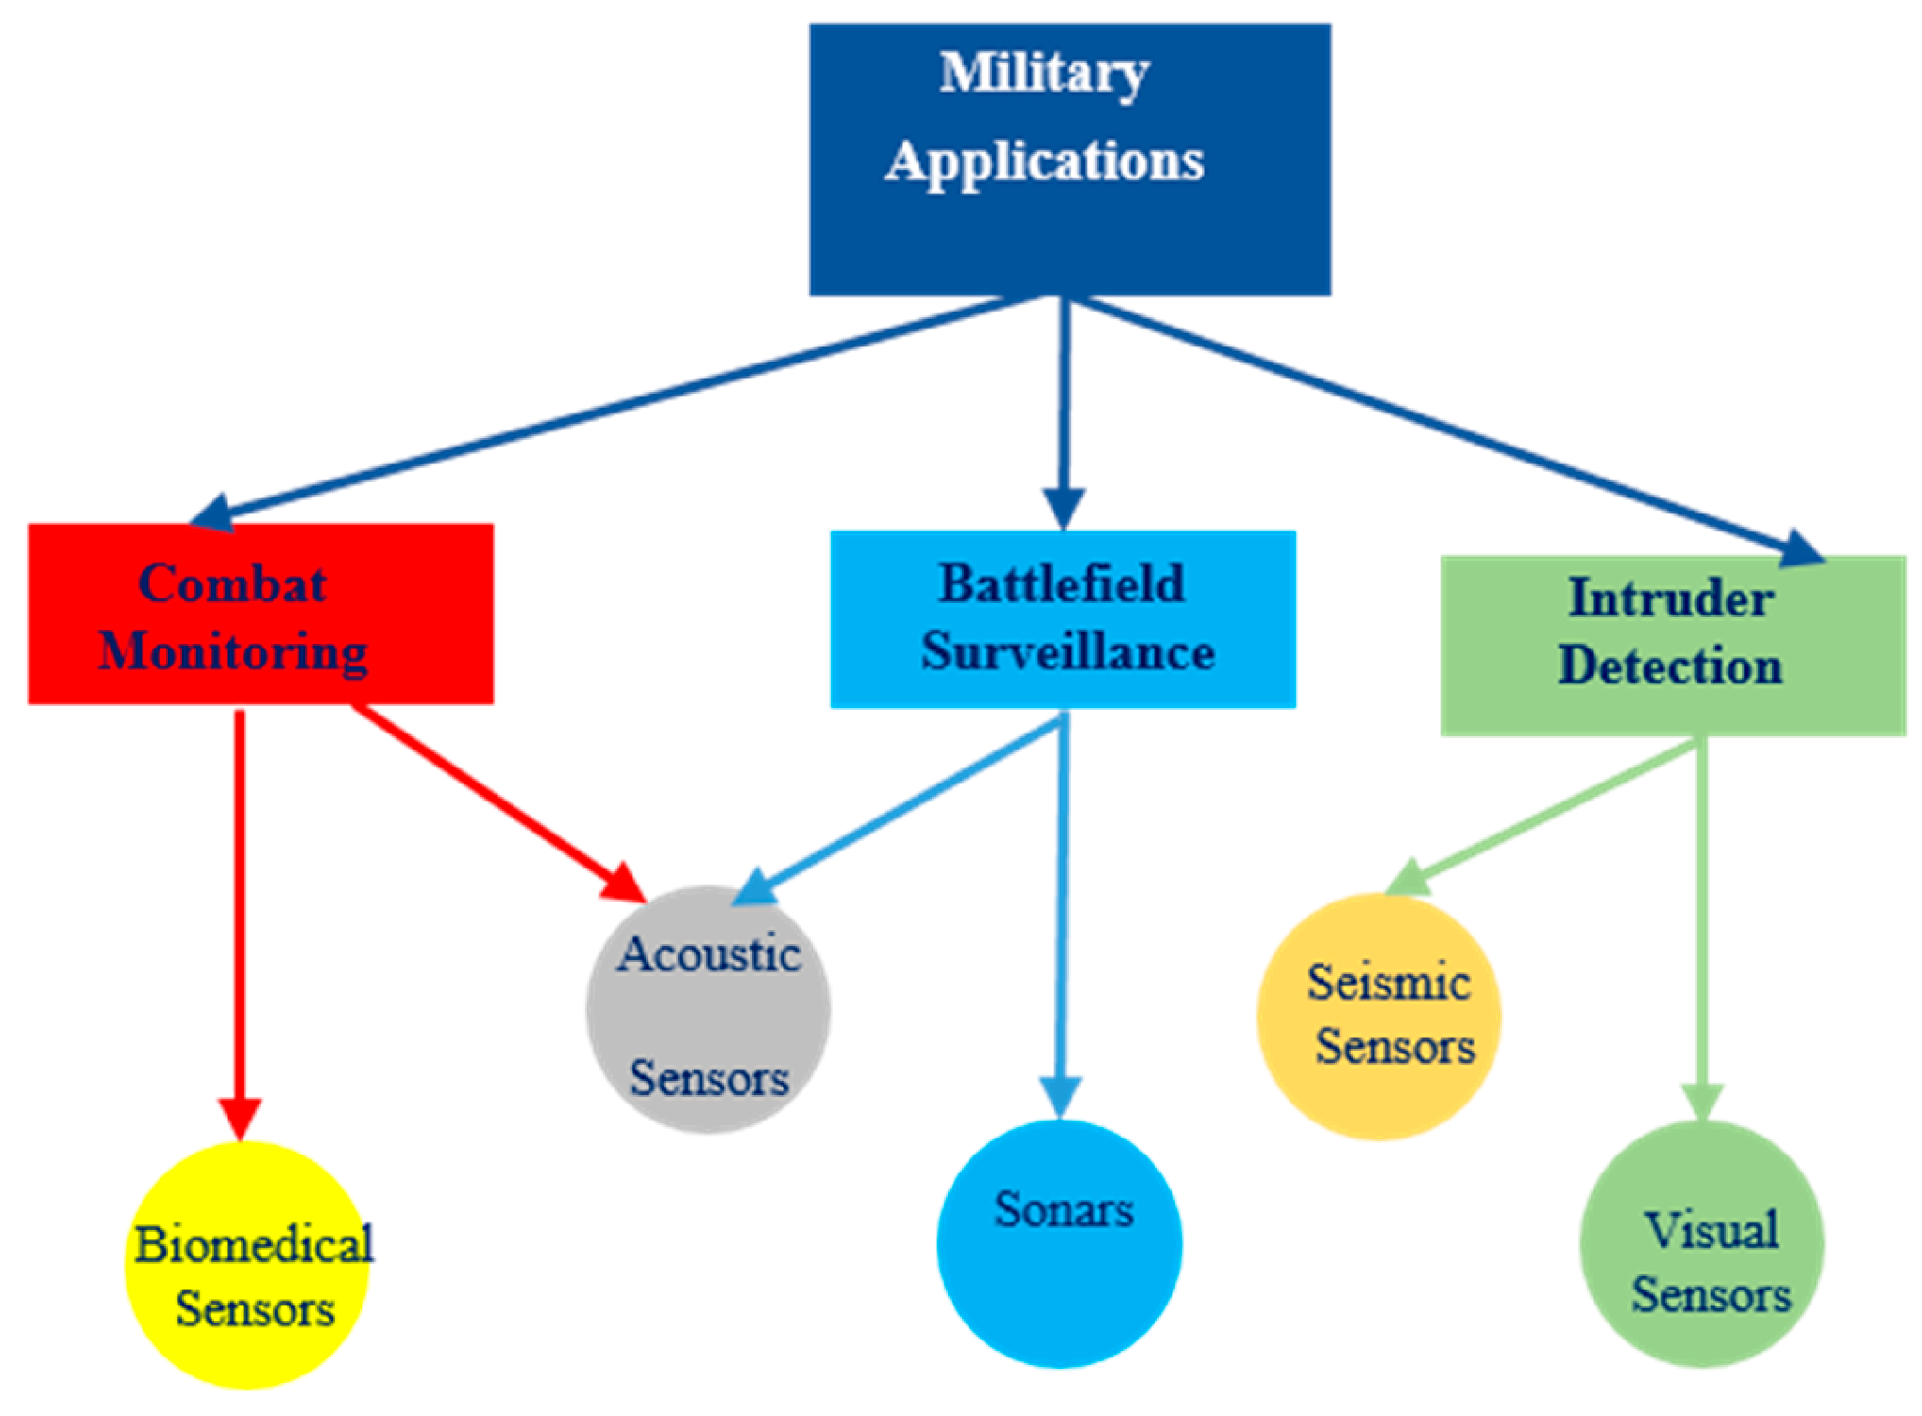
Military

Slide 4
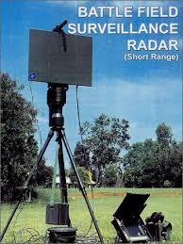
Battlefield Surveillance

Slide 5
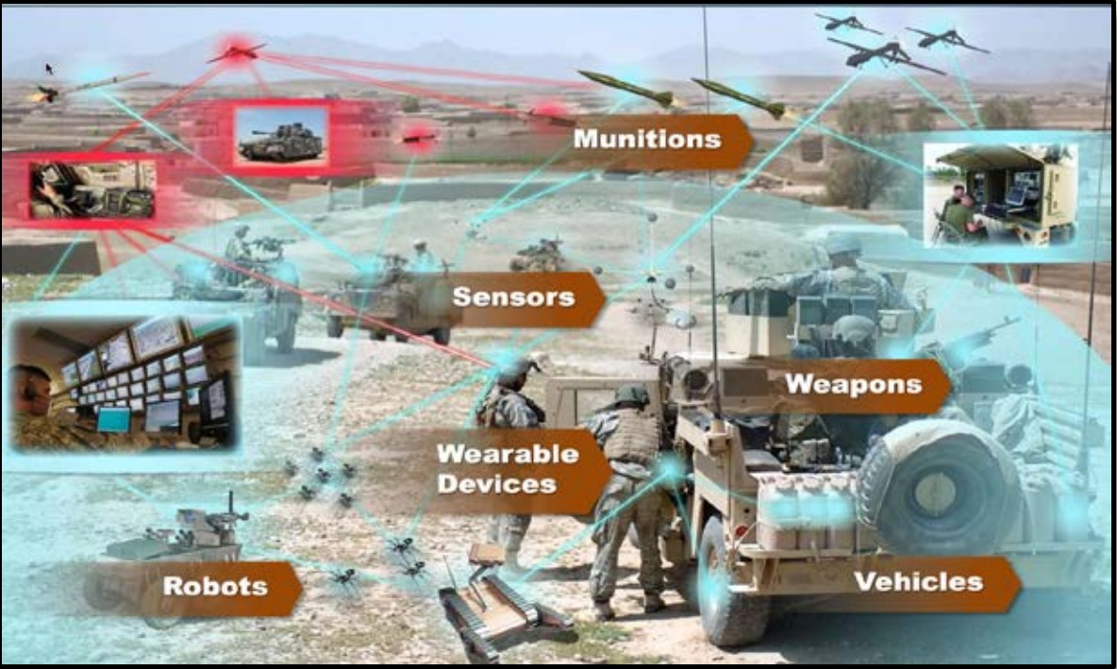
Combat Monitoring

Slide 6
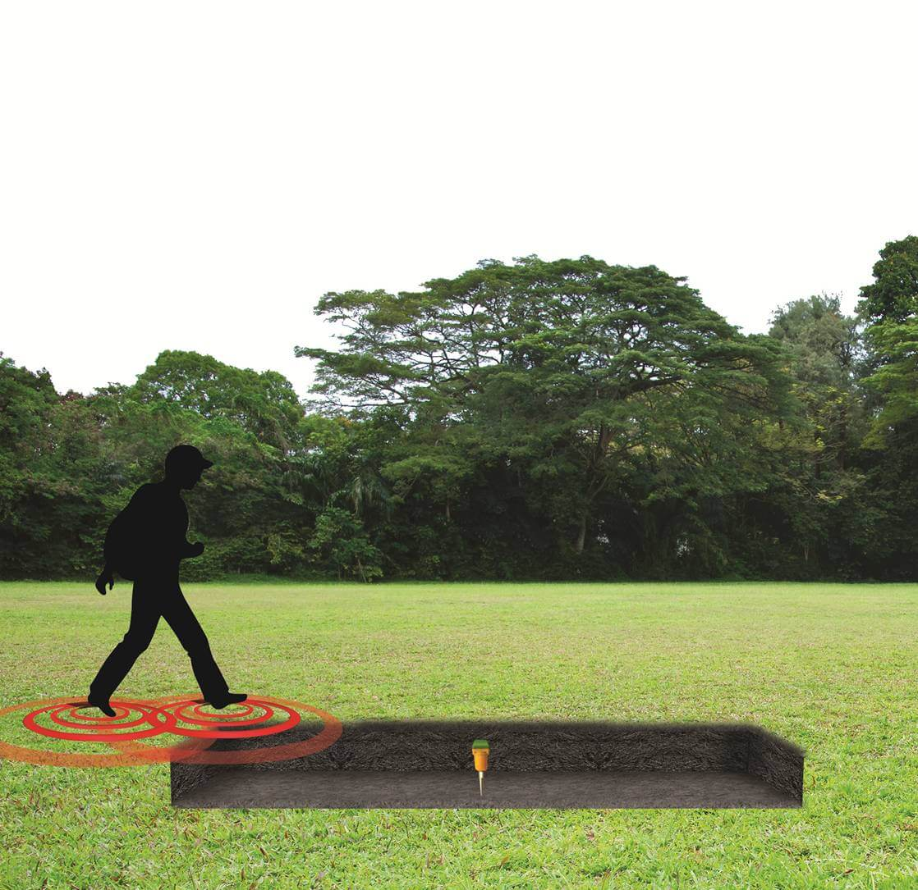
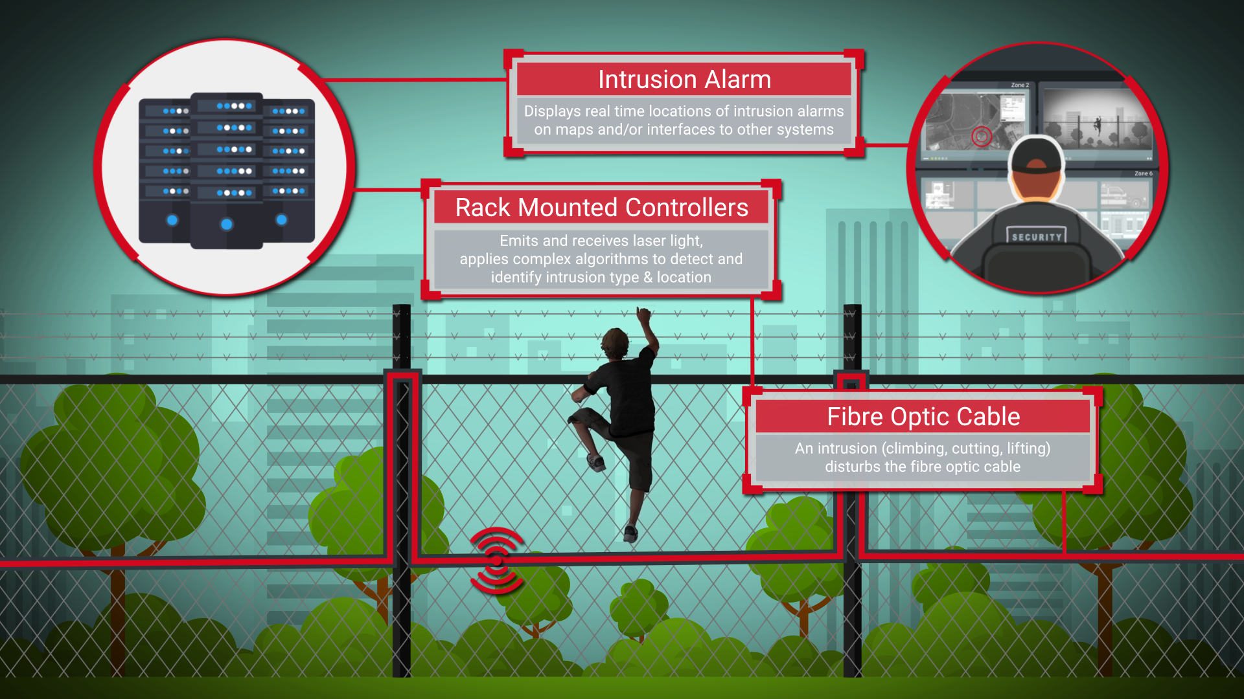
Intruder Detection

Slide 7
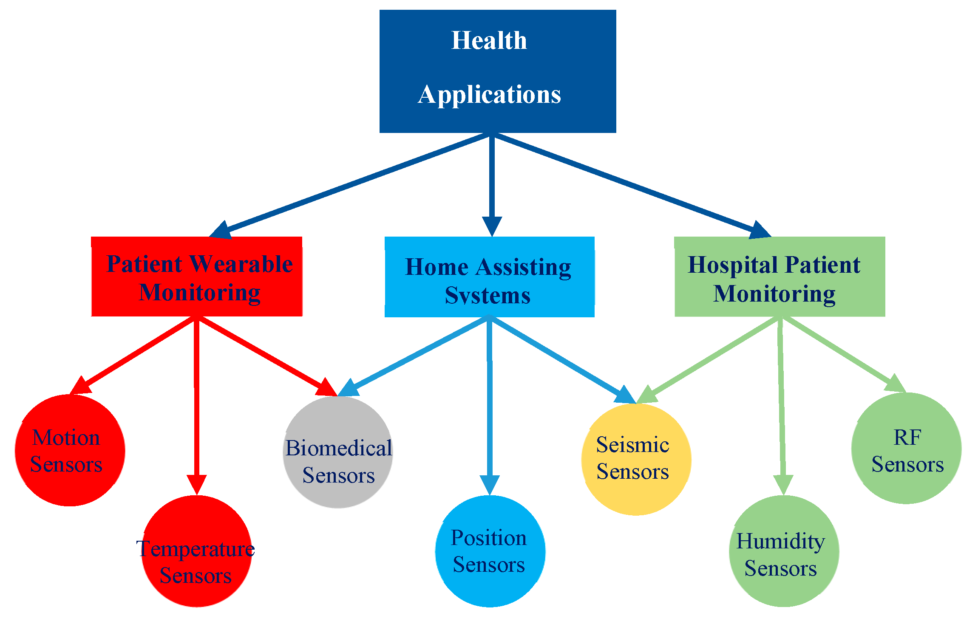
Health Applications

Slide 8
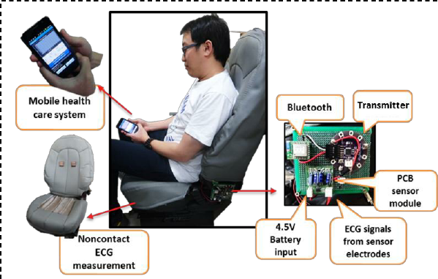
Patient Wearable Monitoring

Slide 9
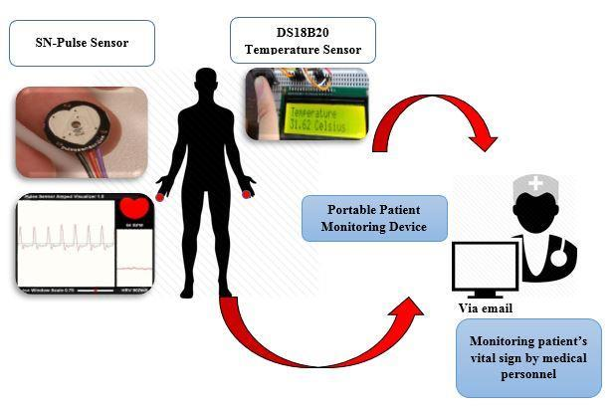
Home Assisting Systems

Slide 10
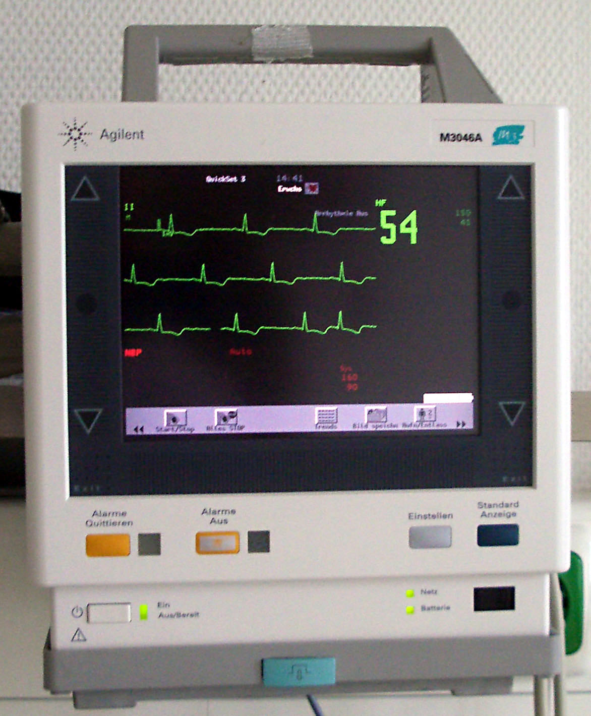
Hospital Patient Monitoring

Slide 11
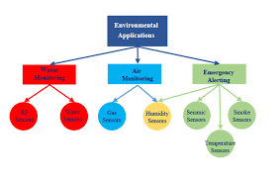
Environmental Applications

Slide 12
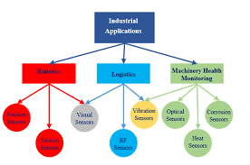
Industrial Applications

Slide 13
Other Applications
Flora and fauna
Crop monitoring
Livestock farming
Urban Applications
Smart cities
Smart homes
Transportation systems
Structural health monitoring

Slide 14
Applications in sports???

Slide 15


Slide 16
References
Kandris, D.; Nakas, C.; Vomvas, D.; Koulouras, G. Applications of Wireless Sensor Networks: An Up-to-Date Survey. Appl. Syst. Innov. 2020, 3, 14.
S. R. Jino Ramson and D. J. Moni, "Applications of wireless sensor networks — A survey," 2017 International Conference on Innovations in Electrical, Electronics, Instrumentation and Media Technology (ICEEIMT), Coimbatore, 2017, pp. 325-329, doi: 10.1109/ICIEEIMT.2017.8116858.

